Slide 1
1 | Workflow
2 | Collate
3 | Batch
4 | Zone Picking
5 | Pick Eligibilities
6 | Picking Cart
7 | Outbound Management
8 | Order Pool
9 | Process Path
10 | Rebatch Station Type
11 | Rebatch Station
12 | Rebin Station Type
13 | Rebin Station
14 | Rebin Wall
15 | Pack Station Type
16 | Pack Station
17 | Box Configure
18 | Pick Path
备注信息：
1.ExSD定义界面
2.扫描枪抓取每个区域员工目前实时工作状态需要再讨论

Slide 2
3-Batch
搜索
批次状态 | PP | ExSD
全选 | 全选 | 全选
Batch ID |  | PP | Batch JobStatus | units | Total | ExSD | Time In Condition | Current Pick Area | Next Step | Current Operator | Current Container
12345678 |  | SingleSmall | 正在拣货 |  | 282 | 2016/11/12 12:00 | 02:10:11 | 1-1-A | Rebin | 张三三 | COB00000001
12345679 |  | SingleSmall | 等待拣货 |  | 200 | 2016/11/12 12:00 | 01:05:21 | 1-1-A | 包装 | - | -
87654321 |  | SingleLarge | 等待拣货 |  | 120 | 2016/11/12 13:00 | 00:21:00 | 1-1-B | 包装
09876543 |  | MultiSmall | 正在拣货 |  | 365 | 2016/11/12 13:00 | 01:10:21 | 1-1-A | Rebin | 王五 | COB00000087
87654321 |  | MultiSmall | 拣货完成 |  | 350 | 2016/11/12 13:00 | 01:15:21 | 1-1-A | Rebin | - | COB00000067
09876543 |  | MultiSmall | 正在Rebin |  | 350 | 2016/11/12 13:00 | 01:15:21 | 1-1-A | 包装 | 李四 | CREBINS0001 CREBINS0002
09876543 |  | MultiLarge | 正在Rebin |  | 90 | 2016/11/12 13:00 | 01:15:21 | 1-1-A | 包装 | 赵大 | CREBINL0009 CREBINL0005
09876543 |  | MultiSamll | Rebin 完成 |  | 360 | 2016/11/12 13:00 | 01:15:21 | 1-1-A | 包装 | - | CREBINS0014 CREBINS0012
22
1
260
200
120
45
1
320
350
22
260
20
70
360

Slide 3
3-Batch
搜索
批次状态 | PP | ExSD
全选 | 全选
Batch ID | PP | Batch JobStatus | units | Total | ExSD | Time In Condition | Current Pick Area | Next Step | Current Operator | Current Container
1234567890 | SingleSmall | 正在拣货 |  | 282 | 2016/11/12 12:00 | 02:10:11 | 1-1-A | 包装 | 张三三 | COB00000001
2345678904 | SingleSmall | 等待拣货 |  | 200 | 2016/11/12 12:00 | 01:05:21 | 1-1-A | 包装 | - | -
2345678909 | SingleLarge | 等待拣货 |  | 120 | 2016/11/12 13:00 | 00:21:00 | 1-1-B | 包装
9876543219 | MultiSmall | 正在拣货 |  | 365 | 2016/11/12 13:00 | 01:10:21 | 1-1-A | Rebin | 王五 | COB00000087
9876543211 | MultiSmall | 拣货完成 |  | 350 | 2016/11/12 13:00 | 01:15:21 | 1-1-A | Rebin | - | COB00000067
9876543211 | MultiSmall | 正在Rebin |  | 350 | 2016/11/12 13:00 | 01:15:21 | 1-1-A | 包装 | 李四 | CREBINS0001 CREBINS0002
9876543211 | MultiLarge | 正在Rebin |  | 90 | 2016/11/12 13:00 | 01:15:21 | 1-1-A | 包装 | 赵大 | CREBINL0009 CREBINL0005
9876543211 | MultiSamll | Rebin 完成 |  | 360 | 2016/11/12 13:00 | 01:15:21 | 1-1-A | 包装 | - | CREBINS0014 CREBINS0012
22
1
260
200
120
45
1
320
350
22
260
20
70
360

Slide 4
3-Batch Job ID查询
Batch Job ID | 12345678
Batch Job Status | Picking
Batch | 43098
Process Path | SingleSmall
ExSD | 2016/11/12 12:00
Operator | 张三三—Assigned At 2016/11/12 11:05:21
备注信息：shipment可以点击查看详情
SKU ID | SKU New Barcode | Status | Order/Moving | SKU Name | Shipment | Cart
1234567890012 | MS123456789 | Moving | 4/4 | 统计学同步辅导与习题全解(人大社·贾俊平·第六版) 平装 |  | COB00000001
234567896789 | MS345678909 | Moving | 5/5 | 统计学同步辅导与习题全解(人大社·贾俊平·第七版) 平装 |  | COB00000001
5678934567894 | MS345678999 | Moving | 4/4 | 统计学同步辅导与习题全解(人大社·贾俊平·第八版) 平装 |  | COB00000001
234567890456 | MS123456789 | Moving | 3/2 | 秘密花园:一本探索奇境的手绘涂色书 |  | COB00000001
2345678903456 | MS234567899 | Moving | 4/3 | Schwarzkopf 施华蔻 臻选发膜组合体验装(羊绒脂发膜50ml+Q10幻时发膜50ml或金致润养发膜50ml+多效19发膜50ml)(商品随机发货)(特卖) |  | COB00000001
234567896789 | MS234567856 | Pending | 5/0 | Schwarzkopf 施华蔻洗发水 金致润养洗发露200ml
1234567
1234757
9034567
9934567
9834567
8734567
7634567

Slide 5
3-Batch ID 查询
Batch ID | 44098
Process Path | SingleSmall
Batch Create | 2016/11/12 10:51:21
Related Location | Rebin：Rebinsmall Pack：Packsmall
ExSD | 2016/11/12 12:00
Cart | COB00000001
备注信息：Shipment可以点击查看详情
备注信息：Order可以点击查看详情
Batch-Job | Shipment |  |  |  |  |  |  | Order
43088—Picking |  | 34567678 | 4567890 | 87654321 | 87654321 | 987654321 |  |  | 8765432 | 765432 | 8765432 | 9876543 | 98765436
 |  | 23456789 | 98765432 | 8765432 | 987654 | 98765432 |  |  | 09876543 | 987654 | 9876543 | 8765432 | 876543
 |  | 8765432 | 8765432 | 8765432 | 765432 | 9876543 |  |  | 9876543 | 98765432 | 9876543 | 9876543 | 87654
 |  | 8765432 | 765432

Slide 6
3-Batch—shipment可以查询
Shipment ID | 1234567
Order ID | 7654321
Batch Job ID | 12345678
Batch Job Status | Picking
Batch | 43098
Process Path | SingleSmall
ExSD | 2016/11/12 12:00
Operator | 张三三—Assigned At 2016/11/12 11:05:21
SKU ID | SKU New Barcode | Status | Order/Moving | SKU Name | Cart
1234567890012 | MS123456789 | Moving | 2/2 | 统计学同步辅导与习题全解(人大社·贾俊平·第六版) 平装 | COB00000001
234567896789 | MS345678909 | Moving | 5/5 | 统计学同步辅导与习题全解(人大社·贾俊平·第七版) 平装 | COB00000001

Slide 7
3-Batch—Order可以查询
Order ID | 7654321
Shipment ID | 1234567
Batch Job ID | 12345678
Batch Job Status | Picking
Batch | 43098
Process Path | SingleSmall
ExSD | 2016/11/12 12:00
Operator | 张三三—Assigned At 2016/11/12 11:05:21
SKU ID | SKU New Barcode | Status | Order/Moving | SKU Name | Cart
1234567890012 | MS123456789 | Moving | 2/2 | 统计学同步辅导与习题全解(人大社·贾俊平·第六版) 平装 | COB00000001
234567896789 | MS345678909 | Moving | 5/5 | 统计学同步辅导与习题全解(人大社·贾俊平·第七版) 平装 | COB00000001

Slide 8
4-Zone Picking
Zone& Batch
Zone& Process Path
备注信息：Pick Area
搜索
PP | EXSD
全选 | 全选

Slide 9
4-Zone Picking
Zone& Batch
Zone& Process Path
备注信息：Pick Area
 | P-1-A | P-1-B | P-1-C | P-1-D | P-2-E | P-2-F | P-2-G | P-2-H | P-2-I | P-3-J | P-3-K | P-3-L | 汇总
SingleSmall | 120 | 100 | 400 | 0 | 20 | 300 | 100 | 30 | 800 | 780 | 0 | 0 | 2650
SingleLarge | 100 | 120 | 410 | 30 | 60 | 280 | 50 | 70 | 700 | 20 | 5 | 60 | 1905
MultiSmall | 80 | 140 | 420 | 60 | 100 | 260 | 0 | 110 | 600 | 900 | 10 | 120 | 2800
MultiLarge | 170 | 160 |  | 90 | 140 | 240 | 300 |  | 500 | 830 | 15 | 180 | 2625
PP1 | 150 |  | 200 | 120 | 10 | 220 | 250 | 40 | 400 | 760 | 20 |  | 2170
PP2 | 130 | 20 | 210 | 150 | 50 | 200 | 200 | 80 | 300 | 690 | 25 | 60 | 2115
汇总 | 750 | 540 | 1640 | 450 | 380 | 1500 | 900 | 330 | 3300 | 3980 | 75 | 420 | 14265

Slide 10
5-Pick Eligibilities
拣货权限修改
拣货权限查看
拣货区域查看
1.权限修改人员选择
搜索
部门 | 经理 | 员工
修改权限
修改区域
2.权限修改类型选择
LockZone | SingleSmall | SingleLarge | MultiSmall | MultiLarge | ******* | ******* | ******** | ******** | *******
3.区域修改类型选择
P-1-A | P-1-B | P-1-C | P-1-D | P-2-E | P-2-F | P-2-G | P-2-H | P-2-I | P-3-J | P-3-K | P-3-L

Slide 11
5-Pick Eligibilities
拣货权限修改
拣货权限查看
拣货区域查看
搜索
员工 | 部门 | 经理 | 当前权限 | LockZone | SingleSmall | SingleLarge | MultiSmall | MultiLarge | ******
鲁A | Outbound | 张三三 | SingleSmall | OK | OK
鲁B | Outbound | 张三三 | SingleLarge |  | OK | OK
鲁C | Outbound | 张三三 | SingleLarge |  | OK | OK | OK | OK
鲁D | Outbound | 张三三 | SingleLarge |  |  | OK
鲁E | Outbound | 张三三 | SingleLarge |  |  | OK

Slide 12
5-Pick Eligibilities
拣货权限修改
拣货权限查看
拣货区域查看
搜索
员工 | 部门 | 经理 | 当前区域 | P-1-A | P-1-B | P-1-C | P-1-D | P-2-E | P-2-F | P-2-G | P-2-H | P-2-I | P-3-J | P-3-K | P-3-L
鲁A | Outbound | 张三三 | P-1-A | OK | OK
鲁B | Outbound | 张三三 | P-1-B |  | OK | OK
鲁C | Outbound | 张三三 | P-1-C |  | OK | OK | OK | OK
鲁D | Outbound | 张三三 | P-1-C |  |  | OK
鲁E | Outbound | 张三三 | P-1-C |  |  | OK

Slide 13
6-Picking Cart
COB00000001
搜索
序号 | Batch ID | Process Path Name | 客户 | SKU NO. | SKU New Barcode | SKU Name | Quatility
1 | 2345678 | SingleSmall | 京东 | 12345678901 | MS123456789 | 统计学同步辅导与习题全解(人大社·贾俊平·第八版) 平装 | 3
2 | 2345678 | SingleSmall | 苏宁 | 98765432109 | MS987654321 | 秘密花园:一本探索奇境的手绘涂色书 | 2

Slide 14
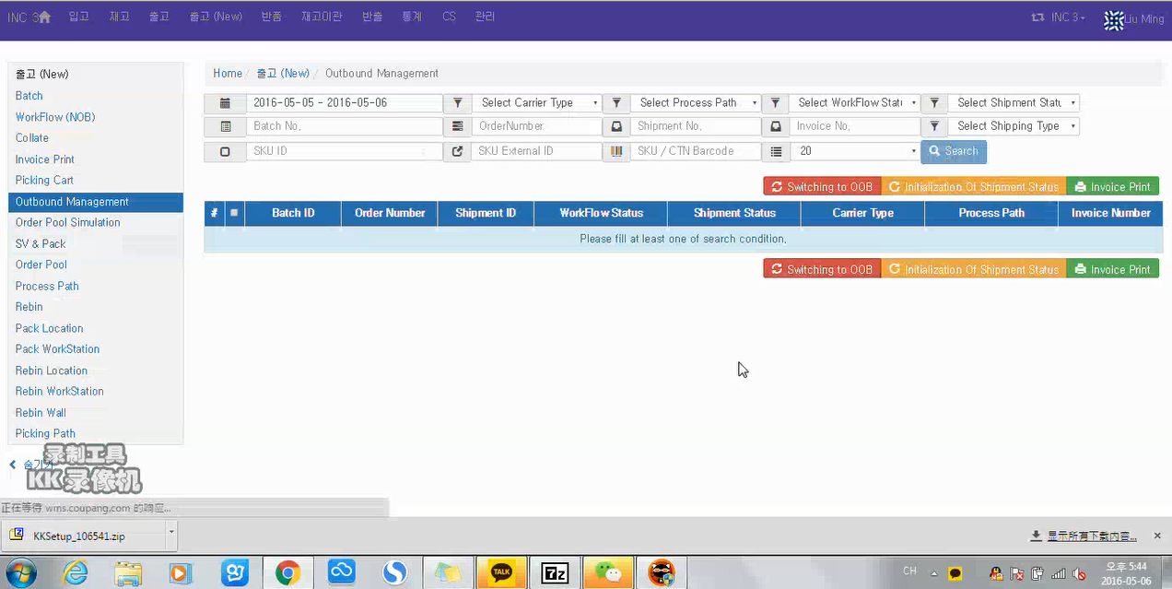
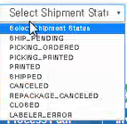
7-Outbound Management-1

Slide 15
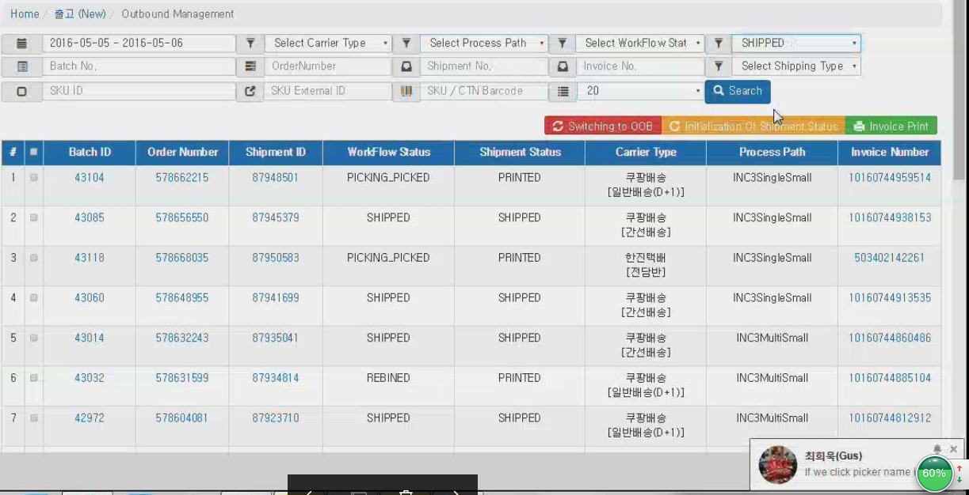
7-Outbound Management-2

Slide 16
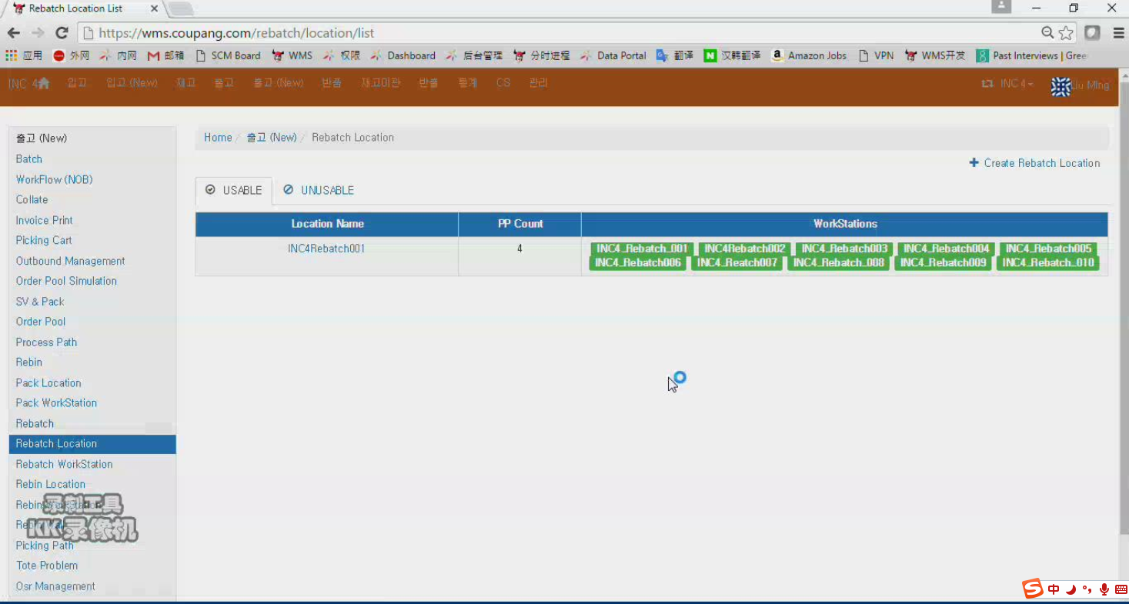
10-Rebatch Station Type

Slide 17
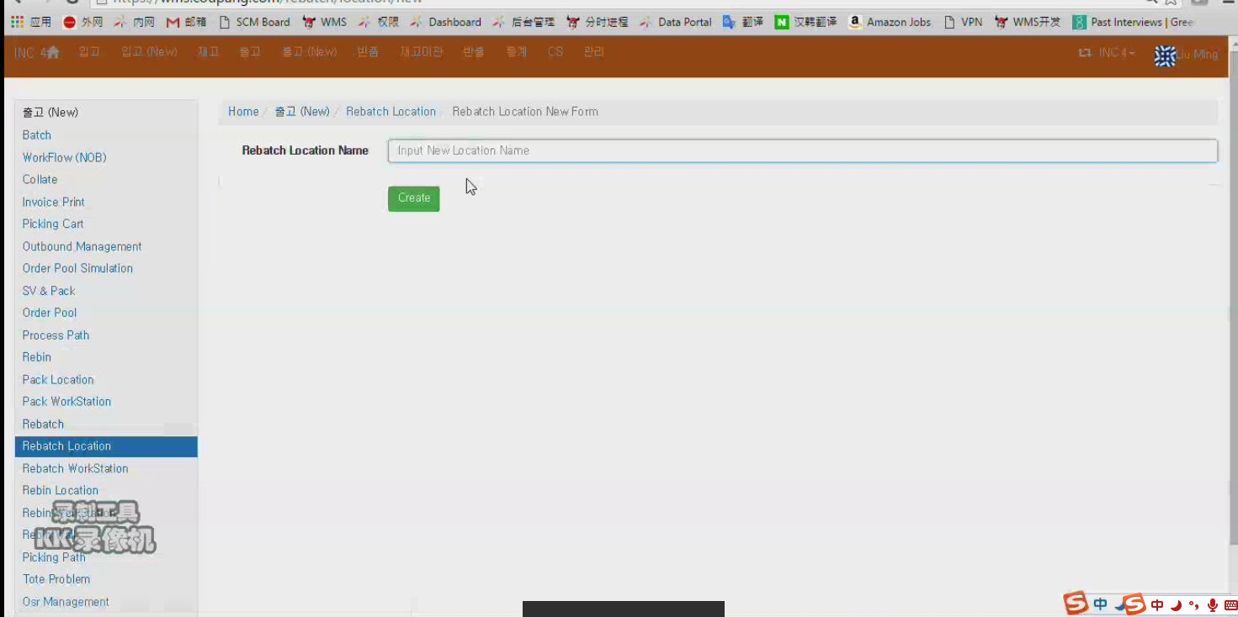
10-Create Rebatch Station Type
Rebatch Station Type

Slide 18
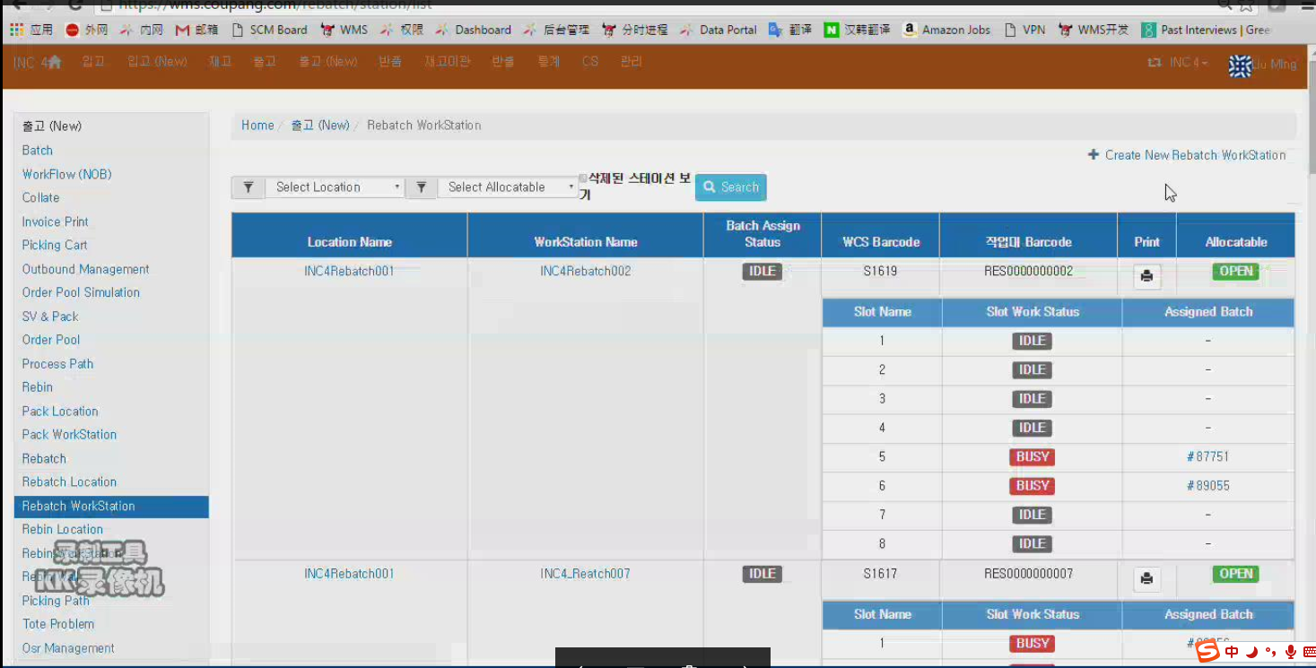
11-Rebatch Station

Slide 19
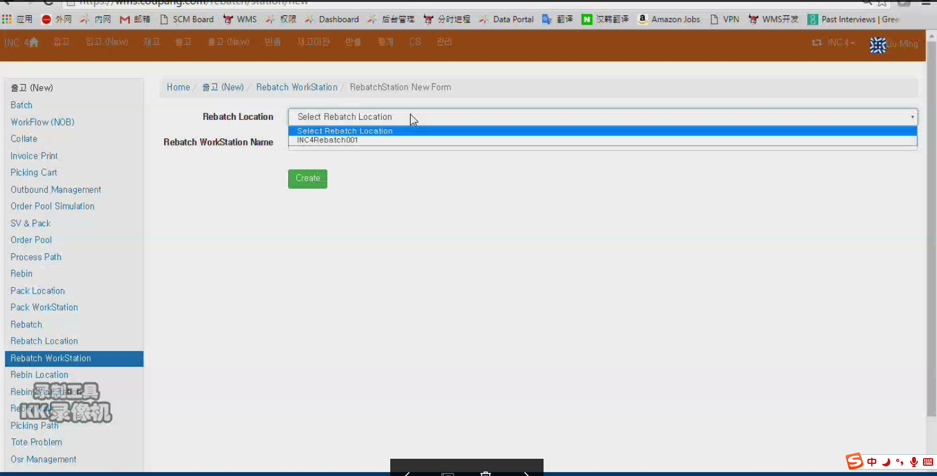
11-Create Rebatch Station
Rebatch Station Type

Slide 20
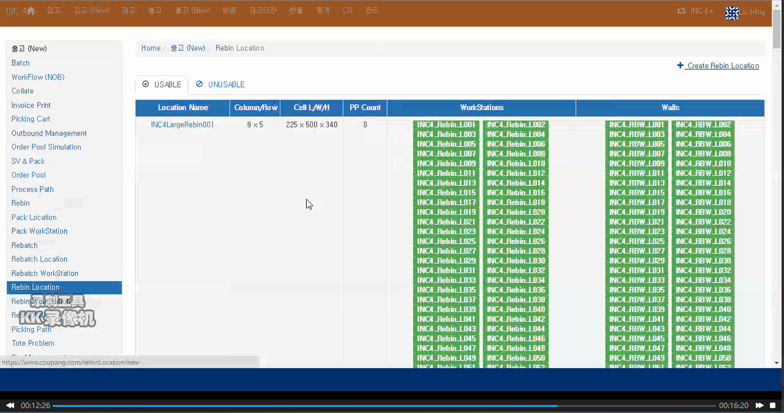
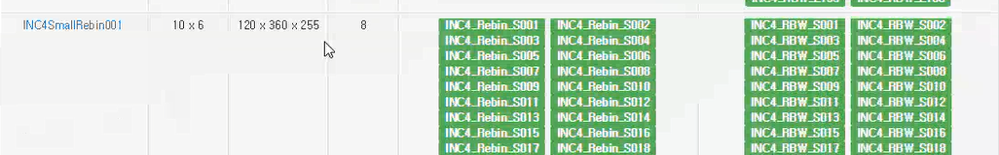
12-Rebin Station Type

Slide 21
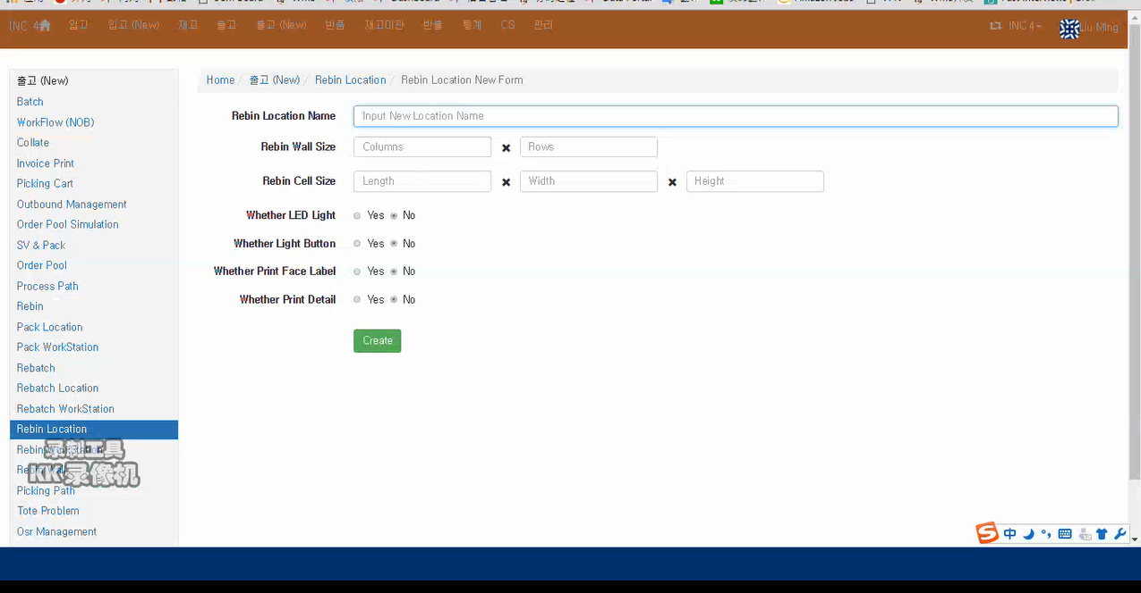
12-Create Rebin Station Type

Slide 22
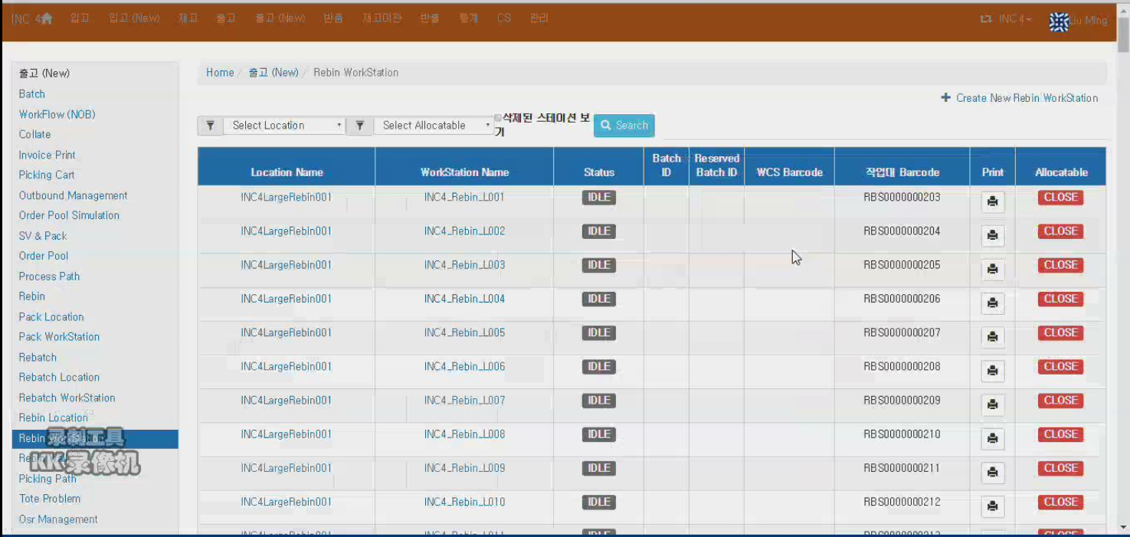
13-Rebin Station

Slide 23
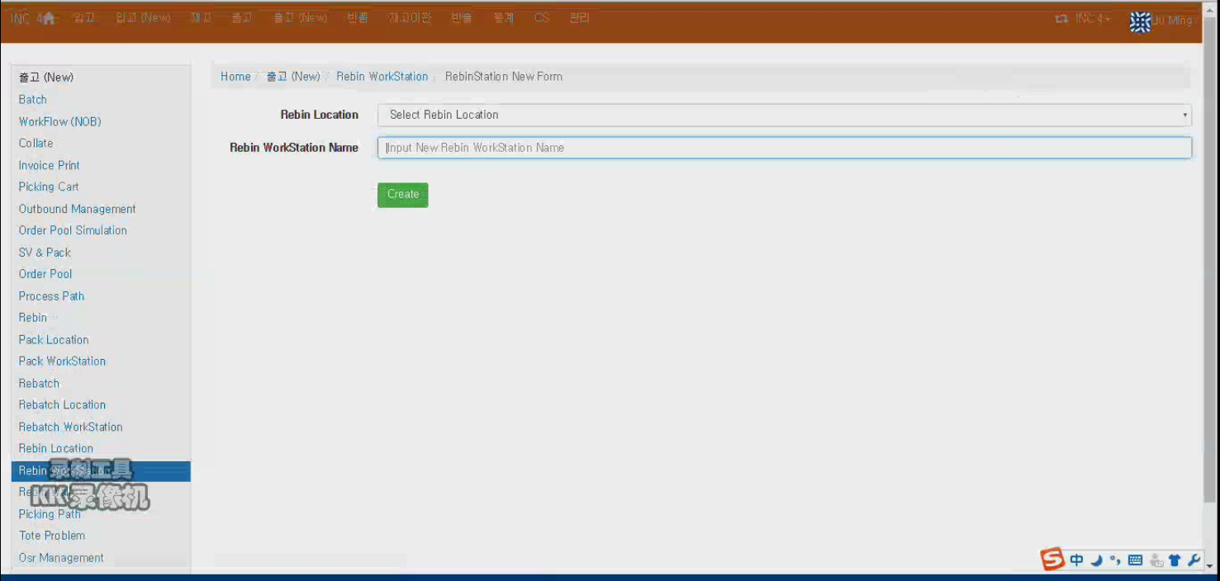
13-Create New Rebin Station
Rebin Station Type

Slide 24
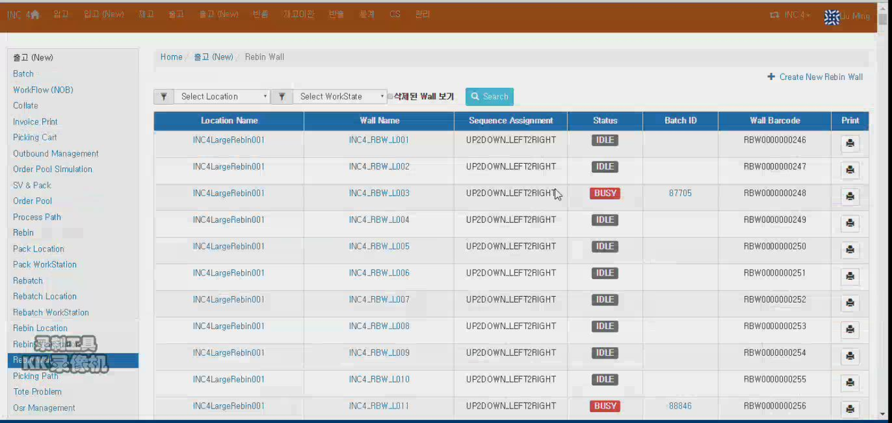
14-Rebin Wall

Slide 25
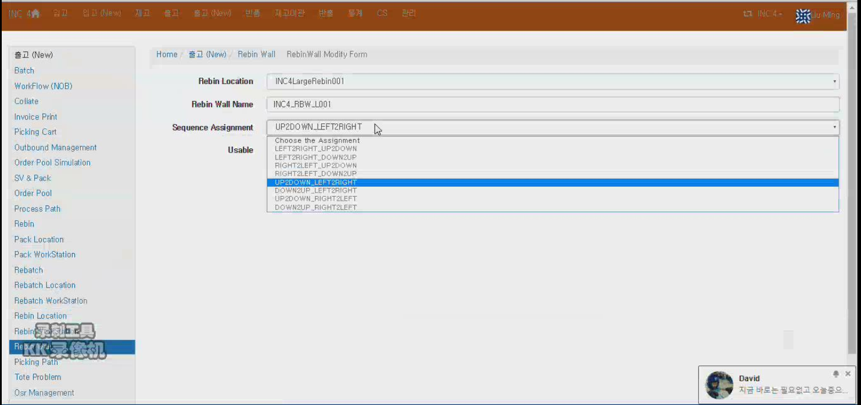
14-Create Rebin Wall
Rebin Station Type

Slide 26
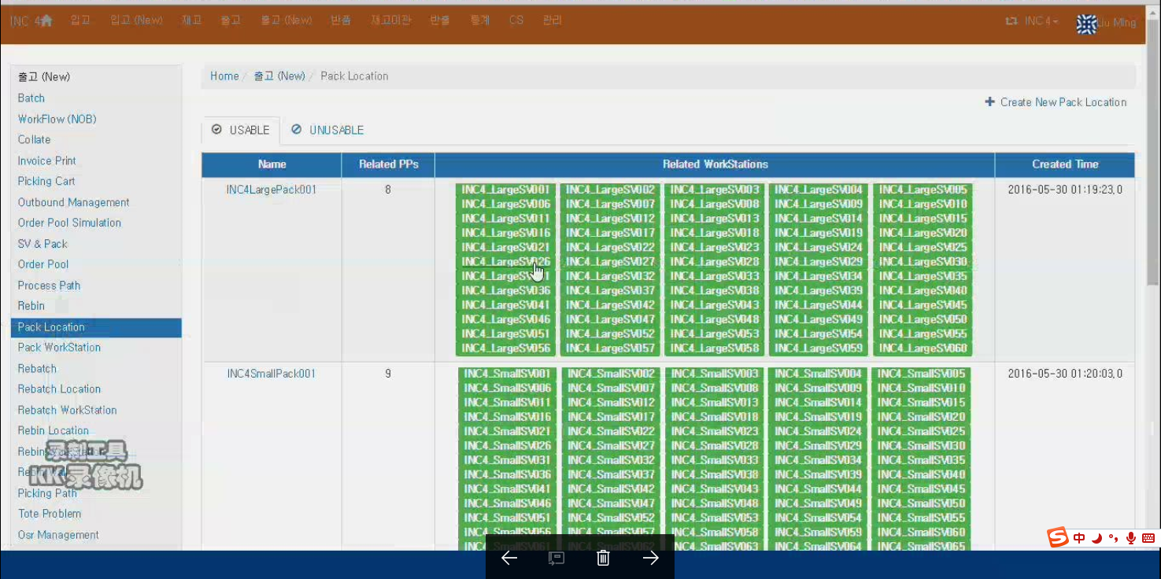
15-Pack Station Type

Slide 27
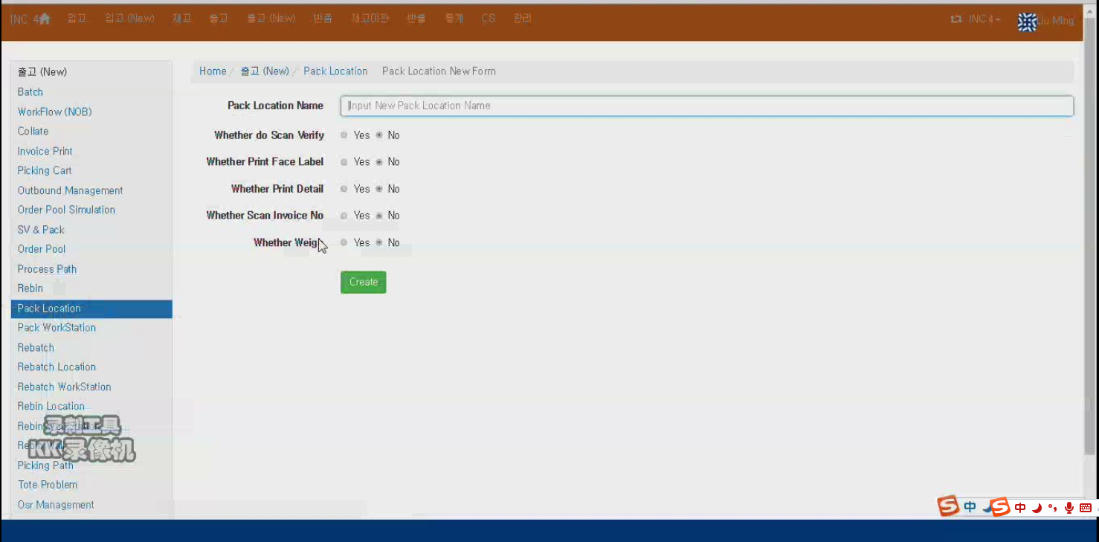
15-Pack Station Type-create a now pack station type
Pack Station Type

Slide 28
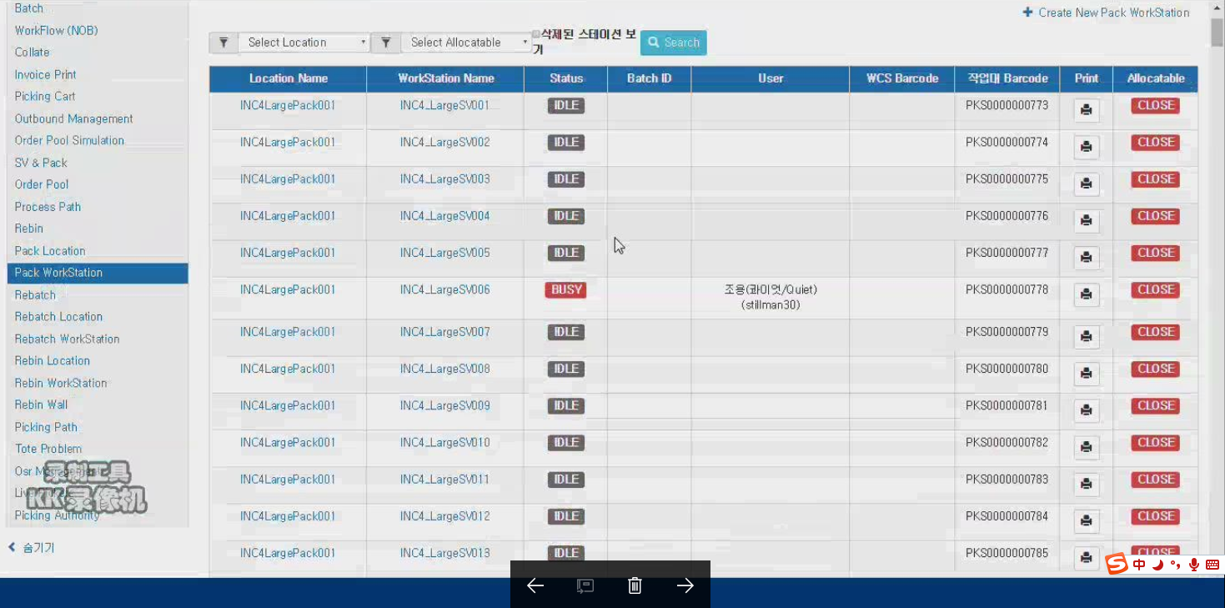
16-Pack Station

Slide 29
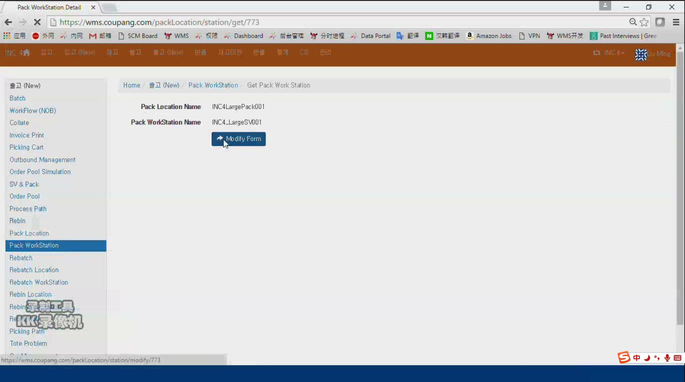
16-查看Pack Station
Pack Station Type name

Slide 30
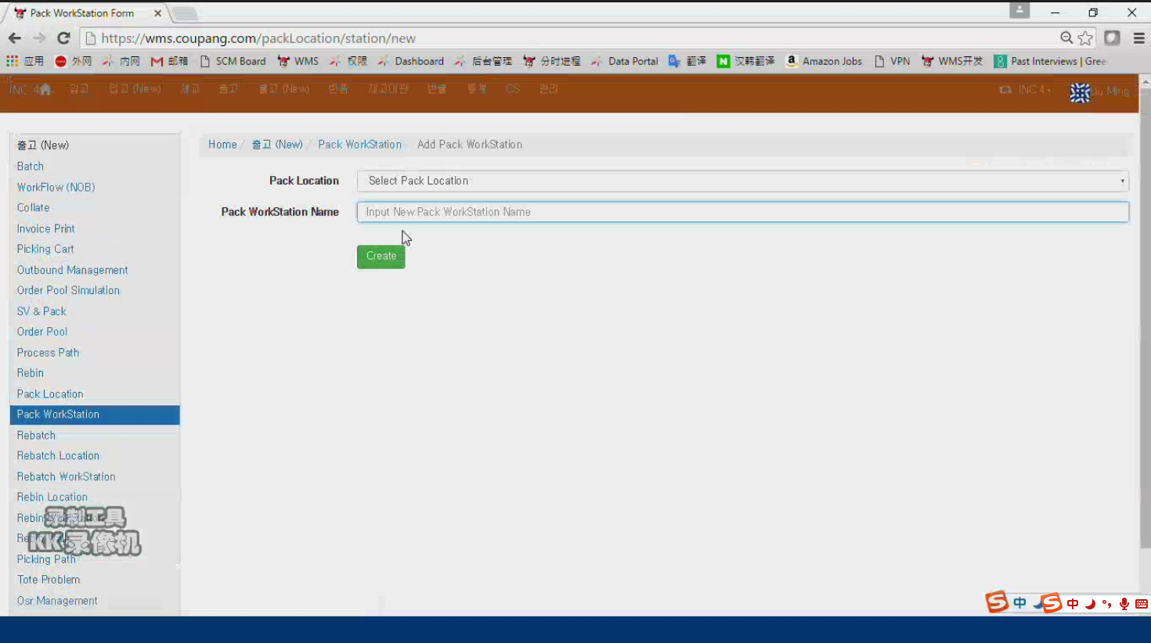
16-创建Pack Station
Pack Station Type

Slide 31
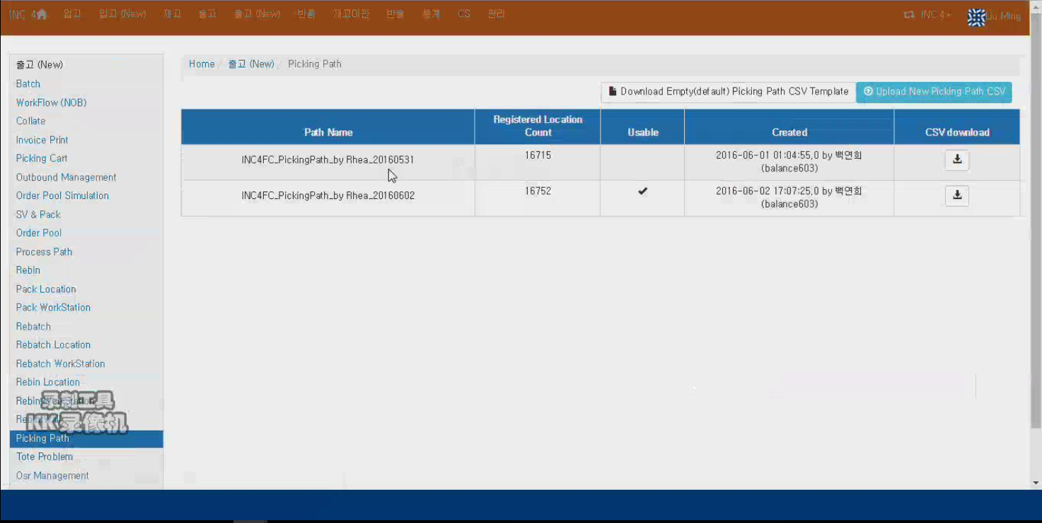
18-Picking Path

Slide 32
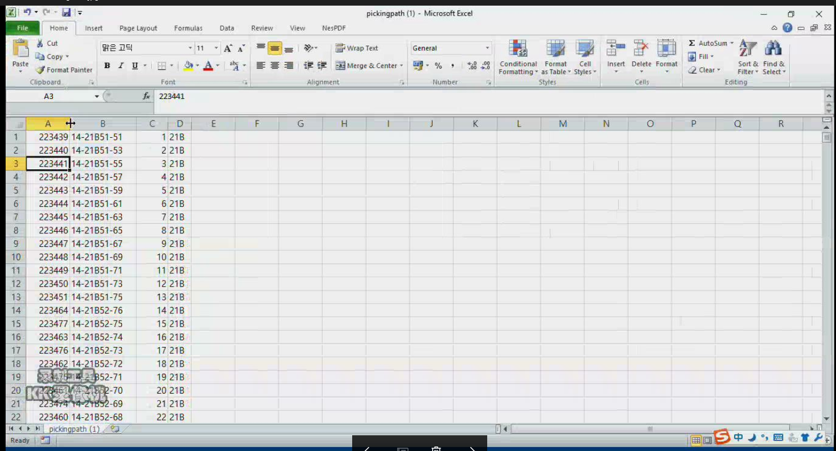
18-Pick Path下载界面

